Slide 1


March 11th 2026

Slide 2



Housekeeping
Housekeeping: emergency exit; toilets; no fire drills
Mobile Phones: on silent please
Questions: Q & A at end of session

Slide 3
Agenda
20:00 | Introduction | Damien Thompson
20:15 | 2026-2027 STW LCS Offer | Julian Povey
20:45 | 2026-2027 GMS Contract Changes (Impositions) | Julian Povey
21:15 | Open Floor & LMC Officer Panel | Nik West
22:00 | Close

Slide 4
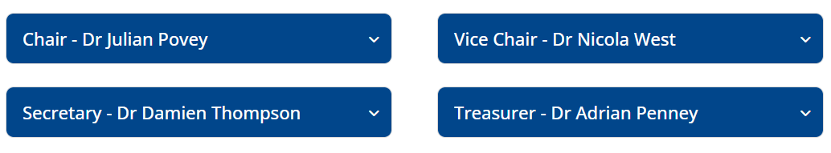
Our Officers

Slide 5
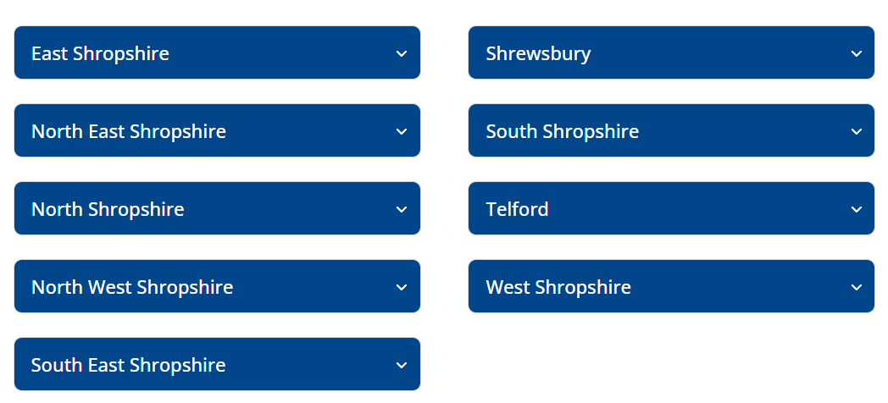
Our Constituencies

Slide 6
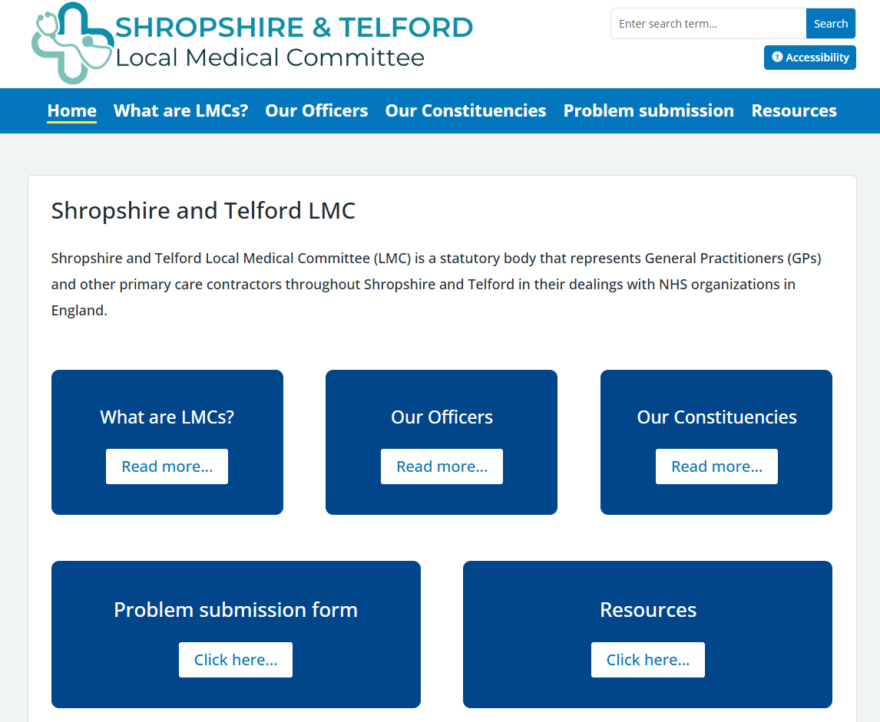

Website
Stw-lmc.com
Stw-lmc.com

Slide 7



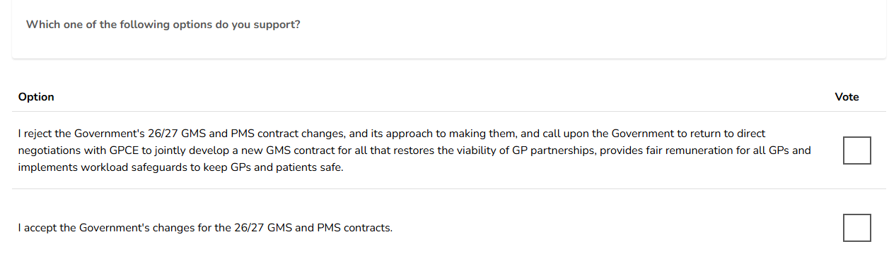
GPCE
Referendum
Vote by March 25th – 12pm

Slide 8
What next?
Depends on you and your vote. We need a united galvanized voice to force Government concessions and return them to the table.
We do not need another ballot. If we have a strong mandate we can progress to immediate action from Wednesday 1st April.
Feedback from 2024- no menus, have a single, simple, unified action.
Escalate with a new action each month, cumulatively
LMC's to reach out to every practice and collate engagement and provide support- feeding up to GPCE nationally.
If actions escalate to breaching the contract then we will hold a ballot with a specific question- likely to be around unlimited demand and safety

Slide 9
Problems? Questions?
Check your junk folders
Check your BMA member profile- are you listed as a GP, practising in England.
Email GPcontract@bma.org.uk and quote your membership number.
Want to join to vote? Visit www.bma.org.uk/join
Want to learn more? Visit www.bma.org/GPcontract

Slide 10

Not had your Ballot?
More information?
Voting link sent on 4th March from Civica. It will come from bma@cesvotes.com

Slide 11

Not a BMA member?
Last day to join
and be able to vote
19th March

Slide 12

GPCE
Elections
The GPCE (England general practitioners committee) are holding regional representative elections from the following regions:
…..
North Staffordshire/South Staffordshire/Shropshire
……
The term for these roles will run from the conclusion of the ARM in July 2026 until July 2029.
Nominations will close at 12pm on Friday 13 March 2026.

Slide 13
LMC Open Meeting 11/3/26

Slide 14
BMA Referendum
LCS 2026/27
New GMS Contract 26/27
Questions
GPC Election 26 – Shropshire/North Staffordshire/South Staffordshire seat

Slide 15
Background to LCS discussions
Agreed with the ICB
  Standardise across Telford & Wrekin & Shropshire
  Acceptance that underfunded so either
    More funding or Fewer Services
  No Practice to lose out
  Keep the finances within General Practice
  ICB have to own any decisions

Slide 16
Previous uplifts
23/24 No Uplift
24/25 5% Uplift
25/26 7.2% Uplift
Overall: 12.55% increase from baseline over those two years

Slide 17
26/27 Changes
Significant Changes
  Moving across both areas to activity based LCSs
  Some LCSs being lost
  Some LCSs being redesigned
  Some new LSCs

Slide 18
Lost LCSs
Shropshire
  Community Care Coordinators £2700 per session per 2000 pts
Telford & Wrekin
  Universal Offer 28p per patient
      Spirometry
      Ear irrigation
      Post Operative wound care
  Demand Management inc minor injuries £4.50 per pt
  Winter Resilience £2.52 per patient

Slide 19

Carried Over LCS
Ear Irrigation
Ring Pessary –initial fit
Ring Pessary - change
Non-Contraceptive IUS
Phlebotomy
SMI
Complex Wound
Minor Injuries
Post Bariatric Surgery

Slide 20
New LCSs
Simple wound and Post-operative wound
Spirometry & FENO
ECG

Slide 21
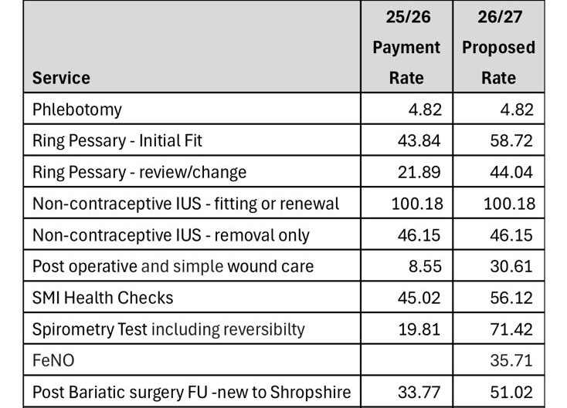

26/27 LCS Rates

Slide 22
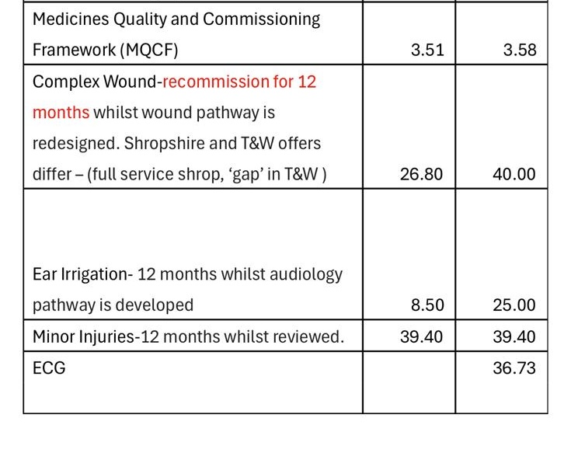
26/27 LCS Rates

Slide 23
Some of the Increased Rates
Spirometry 260% increase on 25/26
Ear Irrigation 195% increase on 25/26
Ring pessary review/change 110% increase on 25/26
Post Operative AND Simple Wounds 258% Increase
Complex wounds 40% Increase
ECG – New service
FENO – New Service

Slide 24
Some rates flat
Phlebotomy
Non-contraceptive IUS
Medicines Quality
ICB did not accept our arguments to apply a growth to all LCS services

Slide 25
26/27 LCS Offer
Overall increase in funding by 1.4m on outturn from 25/26
Varying impact on practices
After removal of CCC Shropshire Practices received significantly less than Telford per patient in 25/26
Plan over 26/27 to redesign LCS package

Slide 26
26/27 LCS Offer
LMC pushed back on a cap
Accepted that ICB will review over and under performers to understand performance
Risk that T&W activity calculation is based on Shropshire Activity
ICB Asking for practices to look to jointly provide some services

Slide 27

Questions

Slide 28
GP Contract Imposition 26/27

Slide 29
GPC England Update
26/27 GP Contracts
26 February 2026

Slide 30
Financial detail

Slide 31
Practice and PCN funding uplift 2026/27
    Provisional combined GP contract and PCN DES uplift of £485m
    £416m going into practice contract funding and £69m into PCN DES
    Combined total now just under £13.9 billion
    This represents a 3.6% cash increase or 1.4% real terms growth relative to GDP deflator, which is used by DDRB, and is 2.23%
    Staff pay assumption of 2.5%, which will be reviewed post-DDRB recommendations and SoS decision
    Funding to cover national costs of other cost pressures (such as list growth)
Notes:
I think it might be worth not mentioning business pressures here at all, in the context of Global Sum, and simply noting the issue when showing the graph on slide 7 – in the context of the total uplift.

Slide 32
Global Sum funding uplift 2026/27
    Context:
    April 2023 Global Sum £102.28 (£104.73 post-DDRB)
    April 2024 Global Sum £107.57 (£112.50 post-DDRB)
    April 2025 Global Sum £121.79 (£123.34 post-DDRB)
    April 2026 Global Sum £128.69, which is a £5.35 (4.3%) uplift
    Pending DDRB recommendation, Government decision, and thus potential further uplift which could see the figure change
Notes:
I think it might be worth not mentioning business pressures here at all, in the context of Global Sum, and simply noting the issue when showing the graph on slide 7 – in the context of the total uplift.

Slide 33
QOF and OOHs deduction
QOF point value will rise from £225.49 to £227.95, an increase of £2.46 (1.1%) following the change in the CPI
OOHs deduction falls from 4.75% to 4.7% due to the exclusion of the Advice and Guidance funding (equivalent to £1.28 PPWP) from the deduction
The OOHs deduction increases from £5.86 to £6.05

Slide 34
SFE reimbursements
Sickness, parental, study and suspension leave reimbursement payments will rise by 2.5%
With a post DDRB recommendation for further uplift pending

Slide 35
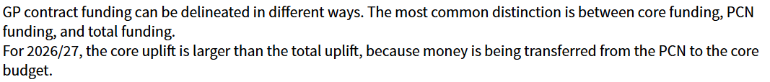
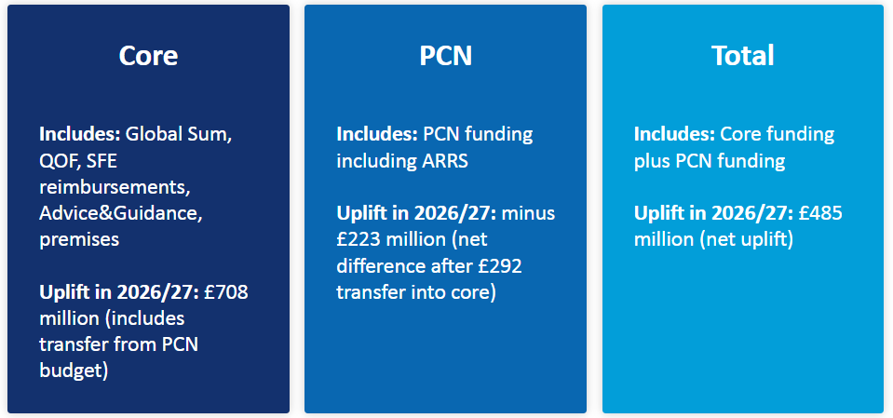
Notes:
I think it might be worth not mentioning business pressures here at all, in the context of Global Sum, and simply noting the issue when showing the graph on slide 7 – in the context of the total uplift.

Slide 36
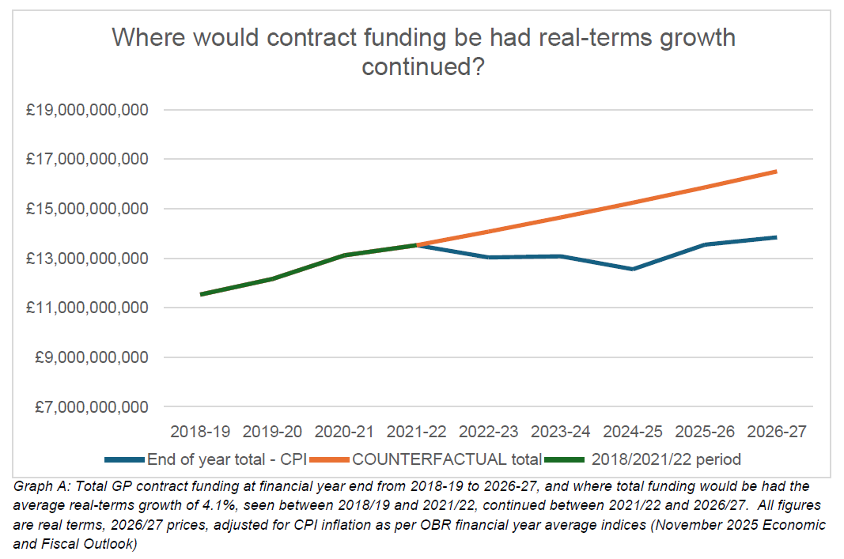

Slide 37
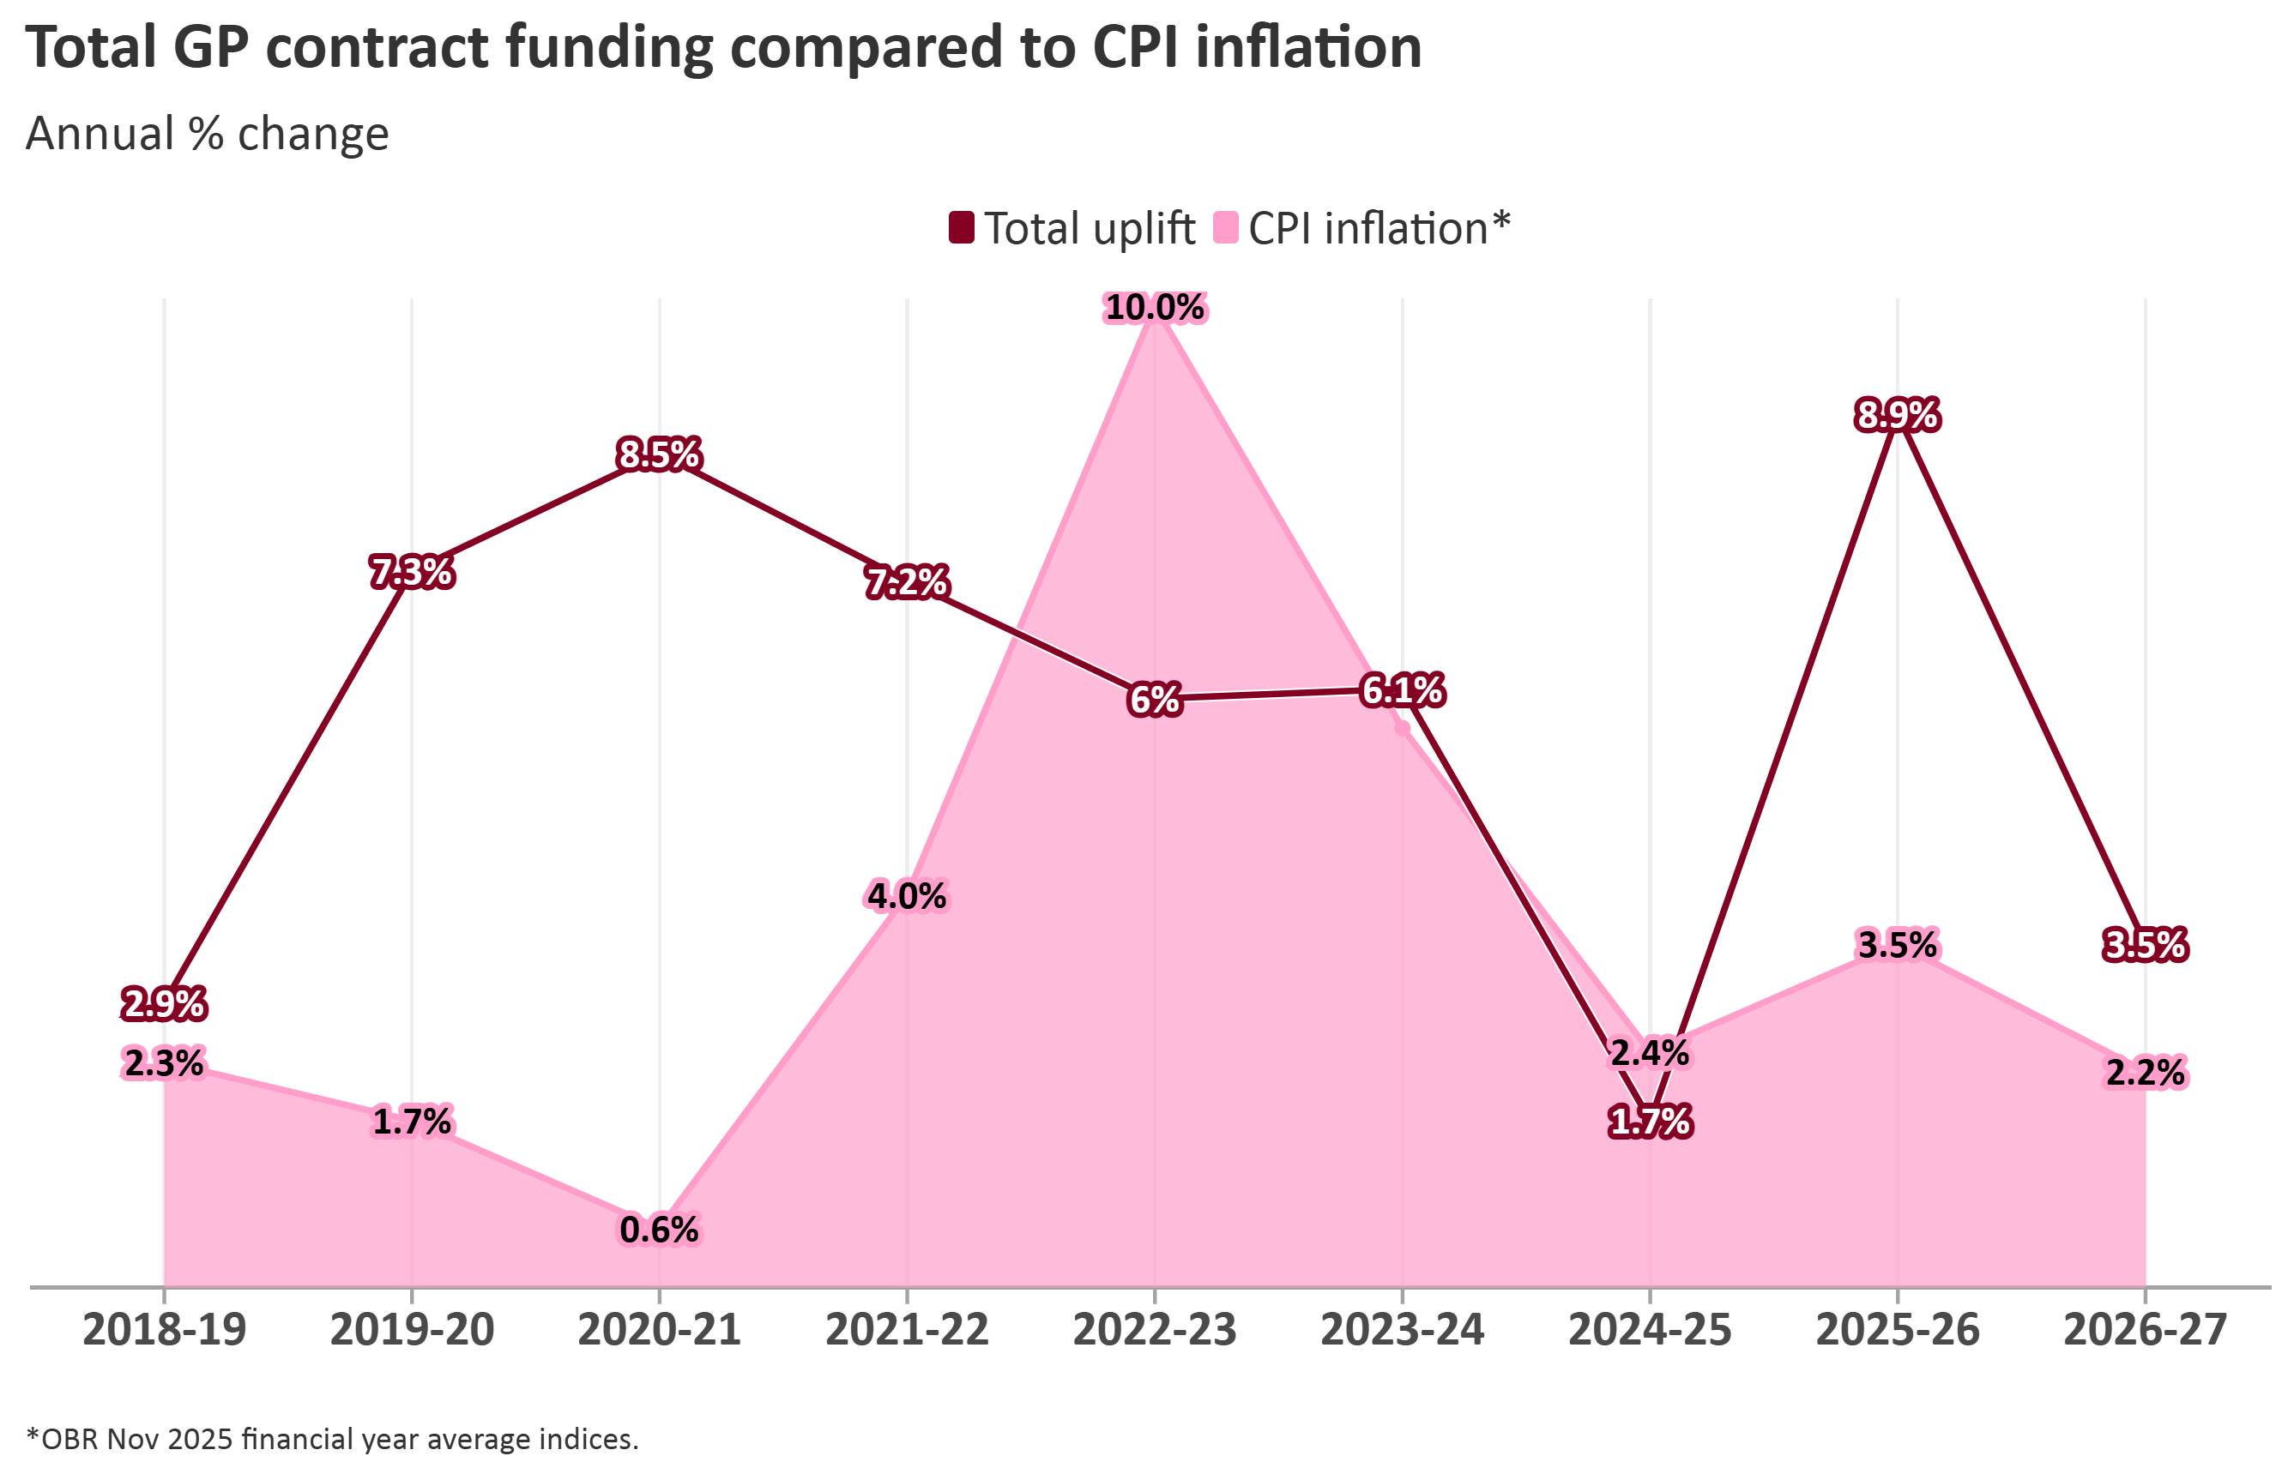
Notes:
Note: DHSC / NHSE increased the provisional combined total uplift from £462m (a 3.5% cash increase) included in their consultation opening letter to GPCE on 1 December 2025 to £485m (a 3.6% cash increase) in their closing letter on 20 February 2026

Slide 38
GMS Contract changes 2026/27

Slide 39
Advice and Guidance
Funding for Advice & Guidance is 2025/26's existing funding (£80m) + £2m uplift = £82m
This goes into Global Sum and becomes recurrent and contractual - £1.28 per weighted patient
The national Advice and Guidance ES is retired – there will be no continuing IoS payments
NHSE MTPF proposals around implementation of 'advice and refer’
Local referral guidelines to be agreed across primary and secondary care: need for strong LMC input and GP voice on top of GPCE work
Notes:
Add SFE references

Slide 40
QOF
18 points worth £25m (new money) added to QOF in 2026/27 for indicator changes with the total number of indicators going from 44 to 43
Key proposals include:
Updating childhood vaccination indicators to reflect JCVI recommendations
Replacing diabetes foot check indicator with a new indicator rewarding delivery of all 8 care processes (including urine Albumin:Cr testing)
Supporting practices to manage obesity by introducing two new indicators
Expanding the provision of annual blood glucose monitoring (adding gestational to PD)
Creating a new indicator for heart failure patients with reduced ejection fraction (HFrEF) to ensure delivery of the NICE-endorsed four-pillar model of treatment
Four blood pressure monitoring indicators to be replaced with two combined indicators
Supporting individualised treatment targets for frail patients
Increasing the upper threshold for the atrial fibrillation indicator for assessing stroke risk

Slide 41
PCN ARRS
The restriction on ARRS funding being claimed only for recently qualified GPs (currently up to 2 years post-CCT) will be removed so that any employed GP may be eligible
The maximum reimbursement for GPs will be increased to the ‘top of the salaried GP pay range’ (£114,743 pre-DDRB)
PCNs will be able to claim reimbursement for GPs up to a maximum of the top of salaried GP pay range plus employment on-costs on top of that
Flexibility will be increased to allow PCNs to also recruit non-direct patient care roles from within the ARRS sum, subject to local commissioner agreement

Slide 42
GP Employment Reimbursement Scheme
Repurposing PCN DES CAIP/CASP monies (£292m) to a new practice-level GP employment reimbursement scheme
Reimbursement to be determined potentially via SFE and ARRS
Original proposal was a set of access metrics
Reduces PCN monies by shifting directly to practices
Reduces potential risk of funds being lost and shifted into SNP contracts/neighbourhood plans

Slide 43
Expansion of RSV cohort
Programme to cover:
All registered patients resident in Care Homes for Older Adults
All registered patients aged 80 and over who have not previously been vaccinated in line with JCVI recommendations
New requirements in the Network Contract DES to increase the uptake of seasonal and routine vaccinations by residents of older adult care homes

Slide 44
Lung Cancer Screening
Practices will be required to engage with and share data with the Lung Cancer Screening Programme to ensure patients within the target cohort can be invited for screening
As the data controller, the GP practice will be required to facilitate the sharing of cohort data with the Lung Cancer Screening Programme
This includes signing Data Sharing Agreements and Data Processing Agreements with Lung Cancer Screening Programme Providers

Slide 45
General Practice Staff Survey
The NHS staff survey will be rolled out to all practice and PCN staff in years when the survey is centrally funded
Practices will be provided with reports, which ‘can be used to help inform workforce development plans and policies’
We made clear that participation must not create additional burdens for practices

Slide 46
Changes to GP registration & catchment area
If a patient presents with a paper form for registration, the practice will be required to enter the information directly into the online registration system
Regulations will be changed so that the digital catchment area is the sole agreed catchment area for the practice
GP practices must submit changes to their catchment area via the digital tool, which will be approved by their ICB

Slide 47
Pharmacy: Patient Choice & Email Contact
Nominated pharmacy must be re-confirmed with the patient for any new prescription
With any new referral made to a community pharmacy service, patients must be offered the full choice of community pharmacies on the NHS England registered list
Any triage tool practices use must enable patients to choose a provider of pharmacy services according to their preference
GP practices to have a dedicated and monitored email address for the purposes of receiving consultation information
Prescribing information delivered to a practice’s registered patient by a community pharmacy to be shared on the DoS

Slide 48
Collaboration with ICBs where a practice requires support
GP practices will be required to engage with support from ICBs in circumstances where unwarranted variation has been identified by the commissioner in contractor performance, and/or the practice is at risk of contractual breach

Slide 49
Cannot ask a patient to call back, or make contact on a different day
Regulations to be amended to specifically set out the requirement that 'practices must not ask patients to call back, or recontact the practice, on another day'
Removal of the requirement that an appropriate response must be provided in the same core hours period, or the next day on which the core hours fall if the contact is made outside core hours – instead will be 'in next working day's core hours'

Slide 50
Same day ‘clinically urgent’ access
It will be made explicit in the GP contract regulations that clinically urgent requests (as defined by the clinical judgment of the GP) must be dealt with on the same day
The annual GP contract guidance will reiterate that 'clinically urgent requests should receive same day appointments'

Slide 51
Unlimited access (no online cap)
An explicit reference will be added to the regulations that GP practices 'must not cap the total number of requests or queries submitted online’ via the software settings
This is 'in addition to the online consultation system being switched on for the duration of core hours'
Guidance will be published for commissioners and GP practices 'to support implementation of these contractual changes'

Slide 52
Displaying opening times for all three modes of access
The Regulations will be updated to make explicit that patients can expect:
that opening times information should be provided for phone line and online consultation availability, in addition to walk-in
that this information should also be displayed in the surgery, and in the practice leaflet, in addition to the practice website
that the hours displayed for all modes of access must be at least the core hours period (08:00 – 18:30)

Slide 53
Timely access to GP access data to support monitoring
The GMS and PMS regs will be amended to enable NHS England to contractually require GP practices to 'provide data and information in relation to online consultation and video consultation services'
The data 'will be extracted directly via the software suppliers'

Slide 54
Sub-contracting
Amendment of the PMS regulations to align with the GMS Regulations
Alignment gives commissioners the same powers to object to sub-contracting as in the GMS contract
Guidance will be drafted 'to support commissioners to enforce the current provisions (in GMS) where existing sub-contracting arrangements are in place’

Slide 55
Continuity of care
The existing CAIP incentive will become a core contractual Network Contract DES requirement for PCNs to risk stratify their patients in accordance with need, including to identify those that would benefit from continuity of care
The entirety of the Capacity and Access Payment funding (including the £292m currently made available to support delivery of this ask in CAIP) to be repurposed in 2026/27 for additional practice-level GP capacity

Slide 56
PCN Cancer requirements
Expansion of the current wording to provide further clarity for PCNs on what they are expected to deliver
The changes are proposed to aid PCNs in:
delivering the requirements of the contract
improving the quality of cancer referrals and early diagnosis rates
improving uptake of non-cancer screening programmes

Slide 57
PCN vaccination collaboration
Proposal to enable practices to voluntarily collaborate for flu and COVID-19 vaccinations under the Network Contract DES
This will happen by retiring separate collaboration agreements and removing existing exclusions from the Mandatory Network Agreement, aligning with the move to practice-level delivery in 2026/27

Slide 58
PCNs to collaborate with ICBs on neighbourhoods
New requirement in the Network Contract DES specification to explicitly require that 'PCNs must work collaboratively with the ICB to achieve greater alignment between the PCN registered list and the neighbourhood'
‘This change is not intended to signal widespread reconfiguration of PCNs, it will apply only in limited circumstances and is a safety net where existing arrangements clearly do not reflect local communities’

Slide 59
In summary (1)
No cap of online consult requests
Greater prominence of displaying opening times for all access modes
Timely access to OC/VC data
Same‑day access for clinically urgent needs
Practices cannot ask patients to call back another day
Subcontracting rules
GP registration & catchment boundaries
Dedicated GP email for pharmacies & promotion of pharmacy choice
General Practice Staff Survey
Lung Cancer Screening Programme data sharing
Requirement to engage with ICB support

Slide 60
In summary (2)
Practice-level GP employment scheme (£292m transferred from PCN DES CAIP)
QOF changes
Minor Vaccinations & Immunisations updates
ARRS expansion and changes to GP elements
Continuity of Care requirement for PCNs
Cancer referral & screening updates for PCN DES
PCN neighbourhood alignment requirement

Slide 61

Any Questions?
This Photo by Unknown Author is licensed under CC BY-SA

Slide 62
Last Thoughts
BMA Webinars
Wednesday 18th March 12-1:30pm
BMA Vote
Contract Referendum
12pm Wednesday 25/3
Join by 19/3
GPC Elections - Julian

